Slide 1
Class 19
Preferential Trading Arrangements by
Alan V. Deardorff
University of Michigan
2020
PubPol/Econ 541

Slide 2
Outline
Background
Simplest model: horizontal supplies
Upward-sloping supplies
  3-country case, in graphs
  Somewhat more general case, in equations
  4-country case, in graphs
Are FTAs Beneficial?

Slide 3
Outline
Background
Simplest model: horizontal supplies
Upward-sloping supplies
  3-country case, in graphs
  Somewhat more general case, in equations
  4-country case, in graphs
Are FTAs Beneficial?

Slide 4
Background
A Preferential Trading Arrangement (PTA)
  Exists when a country uses a lower tariff on one country than on another
Examples
  Free Trade Agreements and Customs Unions
    Zero tariff on (almost) all goods from partner country
  Generalized System of Preferences (GSP)
    Lower than WTO tariffs on some exports of selected developing countries
  ADD, CVD (not Safeguards tariffs, which must apply to all)

Slide 5
Background
A PTA is not the same as lowering a tariff on imports from all countries
Reason: There is both
  “Trade creation”
    Increased imports from the favored partner instead of from domestic producers
  “Trade diversion”
    Switch to import from favored partner instead of from another country (”third country”)

Slide 6
Background
Viner’s (1950) trade creation and trade diversion are usually illustrated with
  Constant costs
  2-country FTA or CU plus rest of world
Then we’ll look at cases with
  Upward sloping supplies
  And in the last case, an FTA when there is another pre-existing FTA

Slide 7
Pause for Discussion

Slide 8
  Questions
Why does the text say that the GATT permission for countries to form FTAs is a “rather strange exception”?
Why do members of a customs union “cede part of their national sovereignty to a supranational entity”?
Why are rules of origin needed in a Free Trade Agreement but not in a Customs Union?
What is diagonal cumulation?

Slide 9
Outline
Background
Simplest model: horizontal supplies
Upward-sloping supplies
  3-country case, in graphs
  Somewhat more general case, in equations
  4-country case, in graphs
Are FTAs Beneficial?

Slide 10
Simplest Model
Assume
  Partial-equilibrium model of trade in a good
    All the same assumptions we’ve used before for tariffs
  3 countries:
    Home, A
    Potential Partner 1, B, and
    Potential Partner 2, C
  B and C have constant costs of exporting to A, at prices P_{B} < P_{C}
  A has tariff, t > P_{C} – P_{B}

Slide 11
No FTA
Home Country A
P
Without FTA
  Since P_{B}+t < P_{C}+t Home imports only from B
S
P_{aut}
P_{C}+t
P_{B}+t
P_{C}
P_{B}
D
S₀
D₀
Q
M₀

Slide 12
FTA with low-cost country, B
Home Country A
P
FTA with B
Since P_{B} < P_{C}+t Home still imports only from B
Country C plays no role
S
P_{aut}
P_{C}+t
P_{B}+t
Welfare
Suppliers lose –a
Demanders gain +(a+b+c+d)
Government loses –c
Country gains +(b+d)
P_{C}
a
b
c
d
P_{B}
D
S₁
S₀
D₀
D₁
Q
M₀
Same as Free Trade

Slide 13
FTA with low-cost country, B
Home Country A
P
S
P_{aut}
P_{C}+t
P_{B}+t
P_{C}
a
b
c
d
P_{B}
D
D₁
S₀
D₀
D₁
Q
M₀
Trade Creation

Slide 14
FTA with high-cost country, C
Home Country A
P
FTA with C
Since P_{C} < P_{B}+t Home now imports only from C
S
P_{aut}
P_{C}+t
Welfare
Suppliers lose –a
Demanders gain +(a+b+c+d)
Government loses –(c+e)
Country loses –e+(b+d)
P_{B}+t
a
b
c
d
P_{C}
e
P_{B}
D
Not same as Free Trade
and may be a loss, if e>(b+d)
S₁
S₀
D₀
D₁
Q
M₀

Slide 15
FTA with high-cost country, C
Home Country A
P
S
P_{aut}
P_{C}+t
P_{B}+t
a
b
c
d
P_{C}
e
P_{B}
Trade Diversion
D
S₁
S₀
D₀
D₁
Q
M₀
Trade Creation

Slide 16
Pause for Discussion

Slide 17
  Questions
If consumers in an FTA buy imports from their FTA partner rather than a non-member due to their paying a lower price, how can that be harmful for the country?
The examples show only trade creation if the PTA is with the low-cost country. Should countries therefore only form PTAs with low-cost countries?

Slide 18
Trade in Services
Trade in a service is not subject to tariffs, since nothing physical crosses borders
It is subject to regulatory standards, which also raise cost, by some amount, say “s”
Assume that FTA removes this cost through
  Harmonization of standards
  Mutual recognition
The difference is that
  Tariff t is revenue to government
  Regulatory cost s is a real cost, using real resources, and not a transfer or benefit to anyone
Pictures look the same as before, except for interpretation of this cost.

Slide 19
Service FTA with low-cost, B
Home Country A
P
FTA with B
Since P_{B} < P_{C}+s Home still imports only from B
Country C plays no role
S
P_{aut}
P_{C}+s
P_{B}+s
Welfare
Suppliers lose –a
Demanders gain +(a+b+c+d)
Government loses 0
Country gains +(b+c+d)
P_{C}
a
b
c
d
P_{B}
D
S₁
S₀
D₀
D₁
Q
M₀

Slide 20
Service FTA with high-cost, C
Home Country A
P
FTA with C
Since P_{C} < P_{B}+s Home now imports only from C
S
P_{aut}
P_{C}+s
Welfare
Suppliers lose –a
Demanders gain +(a+b+c+d)
Government loses 0
Country gains +(b+c+d)
P_{B}+s
a
b
c
d
P_{C}
e
P_{B}
D
Certain gain, but not as large as with country B
S₁
S₀
D₀
D₁
Q
M₀

Slide 21
Pause for Discussion

Slide 22
  Questions
What is the main difference between the effects of a PTA in goods and one in services?

Slide 23
Outline
Background
Simplest model: horizontal supplies
Upward-sloping supplies
  3-country case, in graphs
  Somewhat more general case, in equations
  4-country case, in graphs
Are FTAs Beneficial?

Slide 24
Upward-sloping Supplies
3-country case*
Assume
  Partial-equilibrium model of trade in a good
    All the same assumptions we’ve used before for tariffs
  Three countries, one importer A, and two exporters B, and C
  Export supply and import demands are linear
  Countries B and C are identical
For simplicity
*Much of this is an elaboration of material in World Trade Organization, "Causes and Effects of PTAs: Is it all about preferences?", Ch. C: World Trade Report 2011, pp. 92-121.

Slide 25
Upward-sloping Supplies
3-country case*
Two equilibria:
  0: MFN specific tariff t on exports of both B and C
  1: FTA of A and B:
    tariff t on exports of C;
    zero tariff on exports of B
Assume also: A imports from both B and C in both equilibria
  That’s not guaranteed, but it’s possible as we’ll see, and other cases would be harder

Slide 26






Export Supplies
Export Supplies of B and C
Exports to Country A
P
P
$X^{Bt}+X^{Ct}$
MFN
$X^{Bt}, X^{Ct}$
FTA
$X^{Bf}, X^{Cf}$
$X^{Bf}+X^{Ct}$
$$t$$
$a^{B}=a^{C}$
Q
Q

Slide 27





MFN Equilibrium
Export Supplies
Import Market
P
P
$X^{Bt}+X^{Ct}$
MFN
$X^{Bt}, X^{Ct}$
FTA
$X^{Bf}, X^{Cf}$
$$p_{0}^{A}$$
$X^{Bf}+X^{Ct}$
$$M^{A}$$
$$t$$
$a^{B}=a^{C}$
$$X_{0}^{B}=X_{0}^{C}$$
Q
$$M_{0}^{A}{=X}_{0}^{B}+X_{0}^{C}$$
Q

Slide 28








FTA Equilibrium
Export Supplies
Import Market
P
P
$X^{Bt}+X^{Ct}$
MFN
$X^{Bt}, X^{Ct}$
FTA
$X^{Bf}, X^{Cf}$
$$p_{0}^{A}$$
$X^{Bf}+X^{Ct}$
$$p_{1}^{A}$$
$$M^{A}$$
$$t$$
$a^{B}=a^{C}$
$$X_{0}^{B}$$
$$=X_{0}^{C}$$
Q
Q
$$X_{1}^{C}$$
$$X_{1}^{B}$$
$$M_{0}^{A}$$
$$M_{1}^{A}$$

Slide 29














Trade Creation and Diversion
Export Supplies
Import Market
P
P
$X^{Bt}+X^{Ct}$
MFN
$X^{Bt}, X^{Ct}$
FTA
$X^{Bf}, X^{Cf}$
$$p_{0}^{A}$$
$X^{Bf}+X^{Ct}$
$$p_{1}^{A}$$
$$M^{A}$$
$$t$$
$a^{B}=a^{C}$
TD
TC
$$X_{0}^{B}$$
$$=X_{0}^{C}$$
Q
Q
$$X_{1}^{C}$$
$$X_{1}^{B}$$
$$M_{0}^{A}$$
$$M_{1}^{A}$$

Slide 30


TC & TD, another View
Export Supplies
Import Market
$p^{A}$
$p^{A}$
MFN
$X^{Bt}, X^{Ct}$
$X^{Bt}+X^{Ct}$
FTA
$X^{Bf}, X^{Cf}$
$$p_{0}^{A}$$
$X^{Bf}+X^{Ct}$
$$p_{1}^{A}$$
$$M^{A}$$
$$t$$
TD
$a^{B}=a^{C}$
TC
TC
TD
$$X_{0}^{B}$$
$$=X_{0}^{C}$$
Q
Q
$$X_{1}^{C}$$
$$X_{1}^{B}$$
$$M_{0}^{A}$$
$$M_{1}^{A}$$

Slide 31



Welfare Effects on Country A
Export Supplies
Import Market
Tariff revenue lost from
B C
Net gain of A’s private sector
$p^{A}$
$p^{A}$
MFN
$X^{Bt}, X^{Ct}$
$X^{Bt}+X^{Ct}$
FTA
$X^{Bf}, X^{Cf}$
$$p_{0}^{A}$$
$X^{Bf}+X^{Ct}$
$$p_{1}^{A}$$
$$M^{A}$$
$$t$$
TD
$$a^{B}=a^{C}$$
TC
TC
TD
$$X_{0}^{B}$$
$$=X_{0}^{C}$$
Q
Q
$$X_{1}^{C}$$
$$X_{1}^{B}$$
$$M_{0}^{A}$$
$$M_{1}^{A}$$
See immediately that country A
Gains from trade creation
Loses from trade diversion
As well as from lost revenue from country B

Slide 32

Welfare Effects on Countries B and C
Export Supplies
Import Market
$p^{A}$
$p^{A}$
MFN
Gain by partner country B
$X^{Bt}, X^{Ct}$
$X^{Bt}+X^{Ct}$
FTA
$X^{Bf}, X^{Cf}$
$$p_{0}^{A}$$
$X^{Bf}+X^{Ct}$
$$p_{1}^{A}$$
Loss by outside country C
$$M^{A}$$
$$t$$
TD
$$a^{B}=a^{C}$$
TC
TC
TD
$$X_{0}^{B}$$
$$=X_{0}^{C}$$
Q
Q
$$X_{1}^{C}$$
$$X_{1}^{B}$$
$$M_{0}^{A}$$
$$M_{1}^{A}$$

Slide 33


Welfare Effects on the World
Export Supplies
Import Market
$p^{A}$
$p^{A}$
MFN
$X^{Bt}, X^{Ct}$
$X^{Bt}+X^{Ct}$
FTA
$X^{Bf}, X^{Cf}$
$$p_{0}^{A}$$
$X^{Bf}+X^{Ct}$
$$p_{1}^{A}$$
$$M^{A}$$
$$t$$
TD
$$a^{B}=a^{C}$$
TC
TC
TD
$$X_{0}^{B}$$
$$=X_{0}^{C}$$
Q
Q
$$X_{1}^{C}$$
$$X_{1}^{B}$$
$$M_{0}^{A}$$
$$M_{1}^{A}$$
These add up, with much cancellation to yield the following:

Slide 34







Welfare Effects on the World
Export Supplies
Import Market
$p^{A}$
$p^{A}$
MFN
$X^{Bt}, X^{Ct}$
$X^{Bt}+X^{Ct}$
FTA
$X^{Bf}, X^{Cf}$
$$p_{0}^{A}$$
$X^{Bf}+X^{Ct}$
$$p_{1}^{A}$$
$$M^{A}$$
$$t$$
TD
$$a^{B}=a^{C}$$
TC
TC
TD
$$X_{0}^{B}$$
$$=X_{0}^{C}$$
Q
Q
$$X_{1}^{C}$$
$$X_{1}^{B}$$
$$M_{0}^{A}$$
$$M_{1}^{A}$$
These add up, with much cancellation to yield the following:

Slide 35
Welfare Effects on the World
Export Supplies
Import Market
$p^{A}$
$p^{A}$
MFN
$X^{Bt}, X^{Ct}$
$X^{Bt}+X^{Ct}$
FTA
$X^{Bf}, X^{Cf}$
$$p_{0}^{A}$$
$X^{Bf}+X^{Ct}$
$$p_{1}^{A}$$
$$M^{A}$$
$$t$$
TD
$$a^{B}=a^{C}$$
TC
TC
TD
$$X_{0}^{B}$$
$$=X_{0}^{C}$$
Q
Q
$$X_{1}^{C}$$
$$X_{1}^{B}$$
$$M_{0}^{A}$$
$$M_{1}^{A}$$
These add up, with much cancellation to yield the following:

Slide 36
Welfare Effects on the World
Export Supplies
Import Market
$p^{A}$
$p^{A}$
MFN
$X^{Bt}, X^{Ct}$
$X^{Bt}+X^{Ct}$
FTA
$X^{Bf}, X^{Cf}$
$$p_{0}^{A}$$
$X^{Bf}+X^{Ct}$
$$p_{1}^{A}$$
$$M^{A}$$
$$t$$
TD
$$a^{B}=a^{C}$$
TC
TC
TD
$$X_{0}^{B}$$
$$=X_{0}^{C}$$
Q
Q
$$X_{1}^{C}$$
$$X_{1}^{B}$$
$$M_{0}^{A}$$
$$M_{1}^{A}$$
These add up, with much cancellation to yield the following:

Slide 37
Welfare Effects on the World
Export Supplies
Import Market
$p^{A}$
$p^{A}$
MFN
$X^{Bt}, X^{Ct}$
$X^{Bt}+X^{Ct}$
FTA
$X^{Bf}, X^{Cf}$
$$p_{0}^{A}$$
$X^{Bf}+X^{Ct}$
$$p_{1}^{A}$$
=
$$M^{A}$$
$$t$$
TD
$$a^{B}=a^{C}$$
TC
TC
TD
$$X_{0}^{B}$$
$$=X_{0}^{C}$$
Q
Q
$$X_{1}^{C}$$
$$X_{1}^{B}$$
$$M_{0}^{A}$$
$$M_{1}^{A}$$
These add up, with much cancellation to yield the following:

Slide 38
Welfare Effects on the World
Export Supplies
Import Market
$p^{A}$
$p^{A}$
MFN
$X^{Bt}, X^{Ct}$
$X^{Bt}+X^{Ct}$
FTA
$X^{Bf}, X^{Cf}$
$$p_{0}^{A}$$
$X^{Bf}+X^{Ct}$
$$p_{1}^{A}$$
$$M^{A}$$
$$t$$
TD
$$a^{B}=a^{C}$$
TC
TC
TD
$$X_{0}^{B}$$
$$=X_{0}^{C}$$
Q
Q
$$X_{1}^{C}$$
$$X_{1}^{B}$$
$$M_{0}^{A}$$
$$M_{1}^{A}$$
These add up, with much cancellation to yield the following:

Slide 39
Welfare Effects on the World
Export Supplies
Import Market
$p^{A}$
$p^{A}$
MFN
$X^{Bt}, X^{Ct}$
$X^{Bt}+X^{Ct}$
FTA
$X^{Bf}, X^{Cf}$
$$p_{0}^{A}$$
$X^{Bf}+X^{Ct}$
$$p_{1}^{A}$$
$$M^{A}$$
$$t$$
TD
$$a^{B}=a^{C}$$
TC
TC
TD
$$X_{0}^{B}$$
$$=X_{0}^{C}$$
Q
Q
$$X_{1}^{C}$$
$$X_{1}^{B}$$
$$M_{0}^{A}$$
$$M_{1}^{A}$$
These add up, with much cancellation to yield the following:

Slide 40
Welfare Effects on the World
Export Supplies
Import Market
$p^{A}$
$p^{A}$
MFN
Loss from trade diversion
$X^{Bt}+X^{Ct}$
$X^{Bt}, X^{Ct}$
FTA
$X^{Bf}, X^{Cf}$
$$p_{0}^{A}$$
$X^{Bf}+X^{Ct}$
$$p_{1}^{A}$$
Gain from trade creation
$$M^{A}$$
$$t$$
TD
$a^{B}=a^{C}$
TC
TC
TD
$$X_{0}^{B}$$
$$=X_{0}^{C}$$
Q
Q
$$X_{1}^{C}$$
$$X_{1}^{B}$$
$$M_{0}^{A}$$
$$M_{1}^{A}$$

Slide 41






Why the Loss from Trade Diversion
Export Supplies
Import Market
$p^{A}$
$p^{A}$
MFN
$X^{Bt}, X^{Ct}$
$X^{Bt}+X^{Ct}$
FTA
$X^{Bf}, X^{Cf}$
$$p_{0}^{A}$$
$X^{Bf}+X^{Ct}$
$$p_{1}^{A}$$
$$M^{A}$$
$$t$$
TD
$a^{B}=a^{C}$
TC
TC
TD
$$X_{0}^{B}$$
$$=X_{0}^{C}$$
Q
Q
$$X_{1}^{C}$$
$$X_{1}^{B}$$
$$M_{0}^{A}$$
$$M_{1}^{A}$$
C’s fall in cost
B’s rise in cost

Slide 42
Welfare Effects on the World
Export Supplies
Import Market
$p^{A}$
$p^{A}$
MFN
Loss from trade diversion
$X^{Bt}+X^{Ct}$
$X^{Bt}, X^{Ct}$
FTA
$X^{Bf}, X^{Cf}$
$$p_{0}^{A}$$
$X^{Bf}+X^{Ct}$
$$p_{1}^{A}$$
Gain from trade creation
$$M^{A}$$
$$t$$
TD
$a^{B}=a^{C}$
TC
TC
TD
$$X_{0}^{B}$$
$$=X_{0}^{C}$$
Q
Q
$$X_{1}^{C}$$
$$X_{1}^{B}$$
$$M_{0}^{A}$$
$$M_{1}^{A}$$
Loss is an area, product of the price change and the quantity of trade diversion, with the latter depending on the former.
So the loss rises with the square of trade diversion.

Slide 43
Pause for Discussion

Slide 44
  Questions
Why did we need to assume that “A imports from both B and C in both equilibria.”
  Could it have been otherwise?
  Would it matter for any results?
Why is trade diversion harmful if both exporters initially charge the same price?

Slide 45
Outline
Background
Simplest model: horizontal supplies
Upward-sloping supplies
  3-country case, in graphs
  Somewhat more general case, in equations
  4-country case, in graphs
Are FTAs Beneficial?

Slide 46
Four-Country Model in Equations
Assume
  Partial-equilibrium model of trade in a good
    All the same assumptions we’ve used before for tariffs
  Four countries, one importer A, and three exporters B, C, and D
  Export supply and import demands are linear
  Countries B, C, and D are not assumed identical
Purpose
  To see effect of country A adding a new FTA (with B) when it already has an FTA (with D). (Country C remains an outside country, the rest of world.)

Slide 47
Four-Country Model in Equations
Three equilibria
  0: MFN tariff t on exports of B, C, and D
  1: FTA of A and D:
    Tariff t on exports of B and C;
    Zero tariff on exports of D
  2: FTA of A with B, keeping FTA with D
    Tariff t on exports of C only
    Zero tariff on exports of B and D
Consider only cases with positive exports to A from all three of B, C, and D in all equilibria
Skip to results

Slide 48

The Model
Exports:
Imports:
Equilibrium:
$$X^{i}=b^{i}\left(p^{i}−a^{i}\right), i=B,C,D, p^{i}≥a^{i}$$
$$M^{A}=b^{A}\left(a^{A}−p^{A}\right), { p}^{A}≤a^{A}$$
$$M^{A}=X^{B}+X^{C}+X^{D}$$

Slide 49


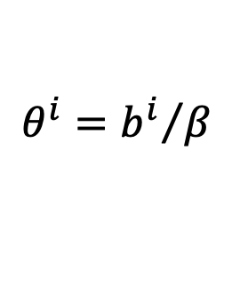

The Model
Let:
Then solution is:
$$β=b^{A}+b^{B}+b^{C}+b^{D}$$
$$θ^{i}={b^{i}}/β$$
$$γ=θ^{A}a^{A}+θ^{B}a^{B}+θ^{C}a^{C}+θ^{D}a^{D}$$
$$p^{A}=γ+θ^{B}t^{B}+θ^{C}t^{C}+θ^{D}t^{D}$$

Slide 50
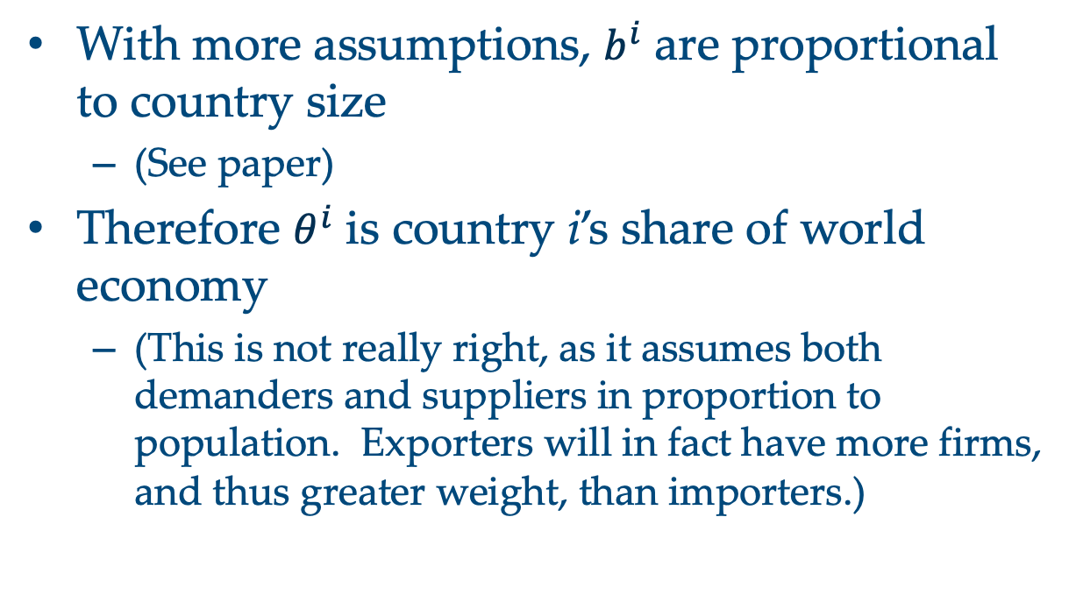
The Model
With more assumptions, $b^{i}$ are proportional to country size
  (See paper)
Therefore $θ^{i}$ is country i’s share of world economy
  (This is not really right, as it assumes both demanders and suppliers in proportion to population. Exporters will in fact have more firms, and thus greater weight, than importers.)

Slide 51

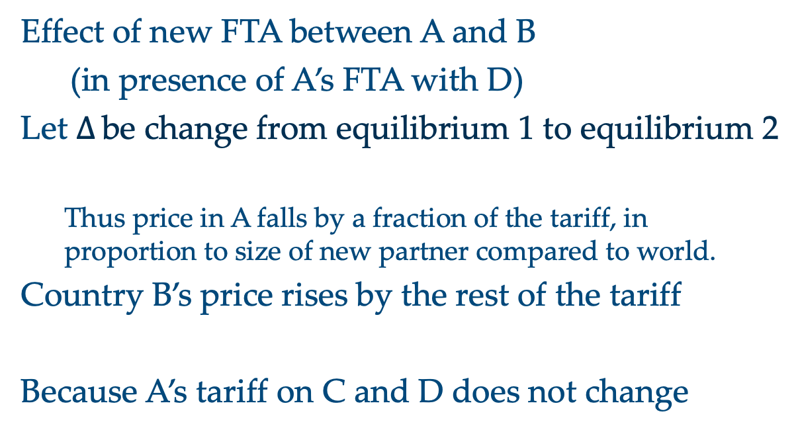


The Model
Effect of new FTA between A and B
(in presence of A’s FTA with D)
Let $∆$ be change from equilibrium 1 to equilibrium 2
  Thus price in A falls by a fraction of the tariff, in proportion to size of new partner compared to world.
Country B’s price rises by the rest of the tariff
Because A’s tariff on C and D does not change
$$∆p^{A}=−θ^{B}t$$
$$∆p^{B}=(1−θ^{B})t$$
$$∆p^{C}=∆p^{D}=∆p^{A}=−θ^{B}t$$

Slide 52




The Model
From the price changes, one derives the following changes in quantities of trade:
$${∆M}^{A}=θ^{B}b^{A}t>0$$
$${∆X}^{B}=θ^{B}\left({b^{A}+b}^{C}+a^{D}\right)t>0$$
$${∆X}^{C}=−θ^{B}b^{C}t<0$$
$${∆X}^{D}=−θ^{B}b^{D}t<0$$

Slide 53
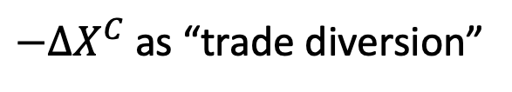

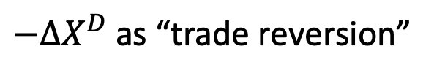
The Model
As must be from market equilibrium
Thus the added exports of the partner country include the new imports of country A plus the reduced exports of countries C and D.
We label
and
because it is reversal of trade diversion from the prior FTA.
${∆X}^{B}={∆M}^{A}−{∆X}^{C}$ $−{∆X}^{D}$
$−{∆X}^{C}$ as “trade diversion”
$−{∆X}^{D}$ as “trade reversion”

Slide 54



The Model
Thus
$$Trade Creation=TC=θ^{B}b^{A}t>0$$
$$Trade Diversion=TD=θ^{B}b^{C}t>0$$
$$Trade Reversion=TR=θ^{B}b^{D}t>0$$

Slide 55
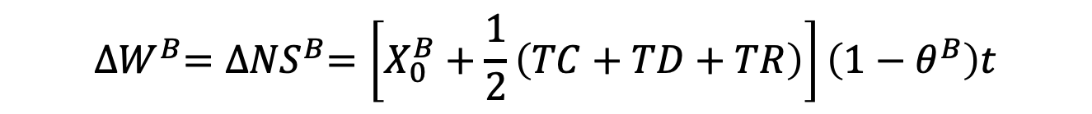
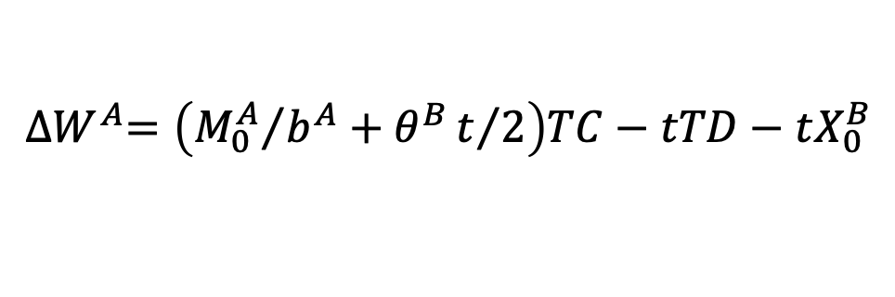
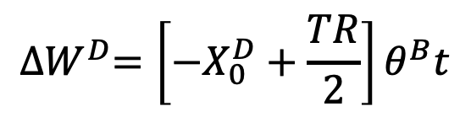
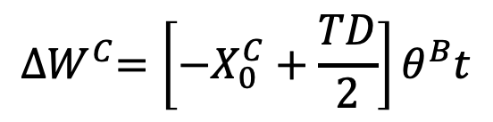
The Model
Welfare effects of new FTA
Country A (home):
Country B (new partner):
Country C (outside world):
Country D (old partner):
Lost tariff revenue
$${∆W}^{A}=\left({M_{0}^{A}}/{b^{A}}+θ^{B}t/2\right)TC−tTD−tX_{0}^{B}$$
$${∆W}^{B}={∆NS}^{B}=\left[X_{0}^{B}+\frac{1}{2}\left(TC+TD+TR\right)\right]\left(1−θ^{B}\right)t$$
$${∆W}^{C}=\left[−X_{0}^{C}+\frac{TD}{2}\right]θ^{B}t$$
$${∆W}^{D}=\left[−X_{0}^{D}+\frac{TR}{2}\right]θ^{B}t$$

Slide 56
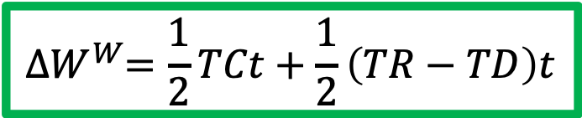
The Model
Welfare effects of new FTA on the World
World (A+B+C+D):
$${∆W}^{W}=\frac{1}{2}TCt+\frac{1}{2}\left(TR−TD\right)t$$

Slide 57
Pause for Discussion

Slide 58
  Questions
Under what circumstances will adding a second FTA be harmful for the world?

Slide 59
Outline
Background
Simplest model: horizontal supplies
Upward-sloping supplies
  3-country case, in graphs
  Somewhat more general case, in equations
  4-country case, in graphs
Are FTAs Beneficial?
Skipping this unless there’s extra time

Slide 60
Four-Country Model in Figures
Four countries:
  Importer A
  Exporters B, C, and D
Export supply and import demands are linear
Countries B, C, and D are identical
For simplicity

Slide 61
Four-Country Model in Figures
Two equilibria
  1: MFN tariff t on exports of both B and C
    Zero tariff on exports of old FTA partner D
  2: New FTA of A and B:
    Tariff t on exports of C only;
    Zero tariff on exports of two FTA partners B and D

Slide 62









Export Supplies
Export Supplies of B, C, and D
Export Supplies to Country B
P
$$X^{Bt}, X^{Ct},X^{Dt}$$
P
${{∑X}_{1}=X}^{Bt}+X^{Ct}$ $+X^{Df}$
$X^{Bf}, { X}^{Cf}$, $X^{Df}$
${{∑X}_{0}=X}^{Bt}+X^{Ct}$ $+X^{Dt}$
${{∑X}_{2}=X}^{Bf}+X^{Ct}$ $+X^{Df}$
$$t$$
$a^{B}=a^{C}$ = $a^{D}$
$b^{B}=b^{C}$ = $b^{D}$
${{∑X}_{f}=X}^{Bf}+X^{Cf}$ $+X^{Df}$
Q
Q

Slide 63



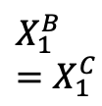


Equilibrium 1: A has FTA with 1 country, D
Export Supplies of B, C, and D
Import Market
P
$$X^{Bt}, X^{Ct},X^{Dt}$$
P
$${∑X}_{1}$$
$X^{Bf}, { X}^{Cf}$, $X^{Df}$
$${∑X}_{2}$$
$$M^{A}$$
$$t$$
$$X_{1}^{B}=X_{1}^{C}$$
$$X_{1}^{D}$$
Q
$$M_{1}^{A}$$
$${=X}_{1}^{B}+X_{1}^{C}+X_{1}^{D}$$
Q

Slide 64



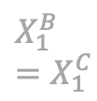

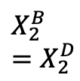


Equilibrium 2: A has FTA with 2 countries, B & D
Export Supplies of B, C, and D
Import Market
P
$$X^{Bt}, X^{Ct},X^{Dt}$$
P
$${∑X}_{1}$$
$X^{Bf}, { X}^{Cf}$, $X^{Df}$
$${∑X}_{2}$$
$$M^{A}$$
$$t$$
$$X_{2}^{C}$$
$$X_{1}^{B}=X_{1}^{C}$$
$$X_{2}^{B}=X_{2}^{D}$$
$$X_{1}^{D}$$
Q
$$M_{1}^{A}$$
$$M_{2}^{A}$$
Q

Slide 65





Changes in Trade from expanding FTA to Country B
Export Supplies of B, C, and D
Import Market
P
$$X^{Bt}, X^{Ct},X^{Dt}$$
P
$${∑X}_{1}$$
$X^{Bf}, { X}^{Cf}$, $X^{Df}$
$${∑X}_{2}$$
$$M^{A}$$
$$t$$
$${∆X}^{C}$$
$${∆X}^{B}$$
$${∆X}^{D}$$
$${∆M}^{A}$$
$$X_{2}^{C}$$
$$X_{1}^{B}=X_{1}^{C}$$
$$X_{2}^{B}=X_{2}^{D}$$
$$X_{1}^{D}$$
Q
$$M_{1}^{A}$$
$$M_{2}^{A}$$
Q

Slide 66

Trade Creation
Trade Creation (TC), Diversion (TD), and Reversion (TR)
Export Supplies of B, C, and D
Import Market
P
$$X^{Bt}, X^{Ct},X^{Dt}$$
P
$${∑X}_{1}$$
$X^{Bf}, { X}^{Cf}$, $X^{Df}$
$${∑X}_{2}$$
$$M^{A}$$
$$t$$
$${∆X}^{C}$$
$${∆X}^{B}$$
$${∆X}^{D}$$
$${∆M}^{A}$$
TD
TR
TC
Q
Q
Trade Diversion
Trade Reversion
Trade Creation

Slide 67



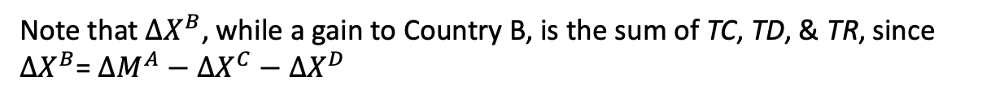

Trade Creation (TC), Diversion (TD), and Reversion (TR)
Export Supplies of B, C, and D
Import Market
P
$$X^{Bt}, X^{Ct},X^{Dt}$$
P
$${∑X}_{1}$$
$X^{Bf}, { X}^{Cf}$, $X^{Df}$
$${∑X}_{2}$$
$$M^{A}$$
$$t$$
$${∆X}^{C}$$
$${∆X}^{B}$$
$${∆X}^{D}$$
$${∆M}^{A}$$
TD
TR
TC
Q
Q
TD
TC
TR
Note that ${∆X}^{B}$, while a gain to Country B, is the sum of TC, TD, & TR, since ${∆X}^{B}$= ${∆M}^{A}−$ ${∆X}^{C}−{∆X}^{D}$

Slide 68



Welfare Effects on Country A
Tariff revenue lost from
Export Supplies of B, C, and D
Import Market
P
$$X^{Bt}, X^{Ct},X^{Dt}$$
P
Net gain of A’s private sector
$${∑X}_{1}$$
B
C
$X^{Bf}, { X}^{Cf}$, $X^{Df}$
$${∑X}_{2}$$
$$M^{A}$$
$$t$$
$${∆X}^{C}$$
$${∆X}^{B}$$
$${∆X}^{D}$$
$${∆M}^{A}$$
TD
TR
TC
$${∆X}^{C}$$
$${∆M}^{A}$$
$${∆X}^{D}$$
Q
Q
TD
TC
TR
Note that trade reversion does not appear to affect A’s welfare. I suspect this is an artifact of making export supplies from B and D the same.

Slide 69
Welfare Effect on Country B
Export Supplies of B, C, and D
Import Market
P
$$X^{Bt}, X^{Ct},X^{Dt}$$
P
$${∑X}_{1}$$
Net gain of B’s private sector
$X^{Bf}, { X}^{Cf}$, $X^{Df}$
$${∑X}_{2}$$
$$M^{A}$$
$$t$$
TD
TR
TC
Q
Q
TD
TC
TR

Slide 70
Welfare Effect on Country C
Export Supplies of B, C, and D
Import Market
P
$$X^{Bt}, X^{Ct},X^{Dt}$$
P
$${∑X}_{1}$$
$X^{Bf}, { X}^{Cf}$, $X^{Df}$
$${∑X}_{2}$$
Net loss of C’s private sector
$$M^{A}$$
$$t$$
TD
TR
TC
Q
Q
TD
TC
TR

Slide 71
Welfare Effect on Country D
Export Supplies of B, C, and D
Import Market
P
Net loss of D’s private sector
$$X^{Bt}, X^{Ct},X^{Dt}$$
P
$${∑X}_{1}$$
$X^{Bf}, { X}^{Cf}$, $X^{Df}$
$${∑X}_{2}$$
$$M^{A}$$
$$t$$
TD
TR
TC
Q
Q
TD
TC
TR

Slide 72
Welfare Effects on World
Export Supplies of B, C, and D
Import Market
P
$$X^{Bt}, X^{Ct},X^{Dt}$$
P
$${∑X}_{1}$$
$X^{Bf}, { X}^{Cf}$, $X^{Df}$
$${∑X}_{2}$$
$$M^{A}$$
$$t$$
TD
TR
TC
Q
Q
TD
TC
TR
I claim that these gains and losses mostly cancel out to reduce to the following:

Slide 73
Welfare Effect on World
Export Supplies of B, C, and D
Import Market
P
$$X^{Bt}, X^{Ct},X^{Dt}$$
P
$${∑X}_{1}$$
$X^{Bf}, { X}^{Cf}$, $X^{Df}$
$${∑X}_{2}$$
$$M^{A}$$
$$t$$
TD
TR
TC
Q
Q
TD
TC
TR

Slide 74
Welfare Effects on World
Export Supplies of B, C, and D
Import Market
P
$$X^{Bt}, X^{Ct},X^{Dt}$$
P
$${∑X}_{1}$$
$X^{Bf}, { X}^{Cf}$, $X^{Df}$
$${∑X}_{2}$$
$$M^{A}$$
$$t$$
TD
TR
TC
Q
Q
TD
TC
TR

Slide 75
Welfare Effects on World
Export Supplies of B, C, and D
Import Market
P
$$X^{Bt}, X^{Ct},X^{Dt}$$
P
$${∑X}_{1}$$
$X^{Bf}, { X}^{Cf}$, $X^{Df}$
$${∑X}_{2}$$
$$M^{A}$$
$$t$$
TD
TR
TC
Q
Q
TD
TC
TR

Slide 76
Welfare Effects on World
Export Supplies of B, C, and D
Import Market
P
$$X^{Bt}, X^{Ct},X^{Dt}$$
P
$${∑X}_{1}$$
$X^{Bf}, { X}^{Cf}$, $X^{Df}$
$${∑X}_{2}$$
$$M^{A}$$
$$t$$
TD
TR
TC
Q
Q
TD
TC
TR

Slide 77
Welfare Effects on World
Export Supplies of B, C, and D
Import Market
P
$$X^{Bt}, X^{Ct},X^{Dt}$$
P
$${∑X}_{1}$$
$X^{Bf}, { X}^{Cf}$, $X^{Df}$
$${∑X}_{2}$$
$$M^{A}$$
$$t$$
TD
TR
TC
Q
Q
TD
TC
TR

Slide 78
Welfare Effects on World
Export Supplies of B, C, and D
Import Market
P
$$X^{Bt}, X^{Ct},X^{Dt}$$
P
$${∑X}_{1}$$
$X^{Bf}, { X}^{Cf}$, $X^{Df}$
$${∑X}_{2}$$
$$M^{A}$$
$$t$$
TD
TR
TC
Q
Q
TD
TC
TR

Slide 79
Welfare Effects on World
Export Supplies of B, C, and D
Import Market
P
$$X^{Bt}, X^{Ct},X^{Dt}$$
P
$${∑X}_{1}$$
$X^{Bf}, { X}^{Cf}$, $X^{Df}$
$${∑X}_{2}$$
$$M^{A}$$
$$t$$
TD
TR
TC
Q
Q
TD
TC
TR

Slide 80
Welfare Effects on World
Export Supplies of B, C, and D
Import Market
P
$$X^{Bt}, X^{Ct},X^{Dt}$$
P
$${∑X}_{1}$$
$X^{Bf}, { X}^{Cf}$, $X^{Df}$
$${∑X}_{2}$$
$$M^{A}$$
$$t$$
TD
TR
TC
Q
Q
TD
TC
TR

Slide 81





Welfare Effects on World
Export Supplies of B, C, and D
Import Market
P
$$X_{1}^{D}$$
$$X^{Bt}, X^{Ct},X^{Dt}$$
P
$${∑X}_{1}$$
$X^{Bf}, { X}^{Cf}$, $X^{Df}$
$$X_{1}^{B}$$
$$X_{1}^{C}$$
$$X_{1}^{D}$$
$$X_{1}^{B}$$
$$=X_{1}^{C}$$
$${∑X}_{2}$$
$$M^{A}$$
$$t$$
TD
TR
TC
Q
Q
TD
TC
TR

Slide 82
Welfare Effects on World
Export Supplies of B, C, and D
Import Market
P
$$X_{1}^{D}$$
$$X^{Bt}, X^{Ct},X^{Dt}$$
P
$${∑X}_{1}$$
$X^{Bf}, { X}^{Cf}$, $X^{Df}$
$$X_{1}^{B}$$
$$X_{1}^{C}$$
$$X_{1}^{D}$$
$$X_{1}^{B}$$
$$=X_{1}^{C}$$
$${∑X}_{2}$$
$$M^{A}$$
$$t$$
TD
TR
TC
Q
Q
TD
TC
TR

Slide 83
Welfare Effects on World
Export Supplies of B, C, and D
Import Market
P
$$X_{1}^{D}$$
$$X^{Bt}, X^{Ct},X^{Dt}$$
P
$${∑X}_{1}$$
$X^{Bf}, { X}^{Cf}$, $X^{Df}$
$$X_{1}^{B}$$
$$X_{1}^{C}$$
$$X_{1}^{D}$$
$$X_{1}^{B}$$
$$=X_{1}^{C}$$
$${∑X}_{2}$$
$$M^{A}$$
$$t$$
TD
TR
TC
Q
Q
TD
TC
TR

Slide 84
Welfare Effects on World
Export Supplies of B, C, and D
Import Market
P
$$X^{Bt}, X^{Ct},X^{Dt}$$
P
$${∑X}_{1}$$
$X^{Bf}, { X}^{Cf}$, $X^{Df}$
$${∑X}_{2}$$
$$M^{A}$$
$$t$$
TD
TR
TC
Q
Q
TD
TC
TR

Slide 85
Welfare Effect on World
Export Supplies of B, C, and D
Import Market
P
$$X^{Bt}, X^{Ct},X^{Dt}$$
P
$${∑X}_{1}$$
$X^{Bf}, { X}^{Cf}$, $X^{Df}$
$${∑X}_{2}$$
$$M^{A}$$
$$t$$
TD
TR
TC
Q
Q
TD
TC
TR

Slide 86
Welfare Effect on World
Export Supplies of B, C, and D
Import Market
P
$$X^{Bt}, X^{Ct},X^{Dt}$$
P
$${∑X}_{1}$$
$X^{Bf}, { X}^{Cf}$, $X^{Df}$
$${∑X}_{2}$$
$$M^{A}$$
$$t$$
TD
TR
TC
Q
Q
TD
TC
TR

Slide 87
Welfare Effect on World
Export Supplies of B, C, and D
Import Market
P
$$X^{Bt}, X^{Ct},X^{Dt}$$
P
$${∑X}_{1}$$
$X^{Bf}, { X}^{Cf}$, $X^{Df}$
$${∑X}_{2}$$
$$M^{A}$$
$$t$$
TD
TR
TC
Q
Q
TD
TC
TR

Slide 88
Welfare Effect on World
Export Supplies of B, C, and D
Import Market
P
$$X^{Bt}, X^{Ct},X^{Dt}$$
P
$${∑X}_{1}$$
$X^{Bf}, { X}^{Cf}$, $X^{Df}$
$${∑X}_{2}$$
$$M^{A}$$
$$t$$
TD
TR
TC
Q
Q
TD
TC
TR

Slide 89
Welfare Effect on World
Export Supplies of B, C, and D
Import Market
P
$$X^{Bt}, X^{Ct},X^{Dt}$$
P
$${∑X}_{1}$$
$X^{Bf}, { X}^{Cf}$, $X^{Df}$
$${∑X}_{2}$$
$$M^{A}$$
$$t$$
TD
TR
TC
Q
Q
TD
TC
TR

Slide 90
Welfare Effect on World
Export Supplies of B, C, and D
Import Market
P
$$X^{Bt}, X^{Ct},X^{Dt}$$
P
$${∑X}_{1}$$
$X^{Bf}, { X}^{Cf}$, $X^{Df}$
$${∑X}_{2}$$
$$M^{A}$$
$$t$$
TD
TR
TC
Q
Q
TD
TC
TR

Slide 91
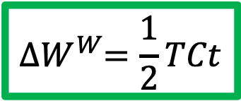
4-country case
Result:
  World welfare rises with second FTA, by amount depending on trade creation and the tariff
Recall from model:
Here, because we’ve assumed countries B and D are the same, TR=TD
$${∆W}^{W}=\frac{1}{2}TCt+\frac{1}{2}\left(TR−TD\right)t$$
$${∆W}^{W}=\frac{1}{2}TCt$$

Slide 92
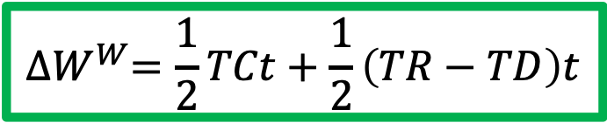

4-country case
In general, $TR≠TD$
Which is larger depends just on country size, size both face the same price change.
If the new partner is smaller than the old, $TR>TD , and world gain will be larger$
If new partner is bigger than old, then $TR<TD$ and world gain will be smaller and perhaps a loss.
$${∆W}^{W}=\frac{1}{2}TCt+\frac{1}{2}\left(TR−TD\right)t$$

Slide 93
Conclusion
Analysis of FTAs shouldn’t treat each independently of FTAs that already exist
Sequencing of FTAs can matter.

Slide 94
Pause for Discussion

Slide 95
  Questions
Why is adding a second FTA not harmful for the world in the graphs, but may be harmful in the world in the equations?

Slide 96
Outline
Background
Simplest model: horizontal supplies
Upward-sloping supplies
  3-country case, in graphs
  Somewhat more general case, in equations
  4-country case, in graphs
Are FTAs Beneficial?

Slide 97
Are FTAs Beneficial?
My own work suggests that they are, though the benefits are not huge
But many (not economists) disagree
Much has been said about NAFTA
  It’s political reputation has been negative
    Labor unions
    Democrats
    Trump
  Economists have been more positive
    See Posen (economist and President of Peterson Institute of International Economics)

Slide 98
Are FTAs Beneficial
Posen’s points
  Consumers in all three countries have gained.
  Workers have suffered, but not from NAFTA.
  “Recent research has found that, on average, for every 100 jobs US manufacturers created in Mexican manufacturing, they added nearly 250 jobs at their larger US home operations…”
  Until the financial crisis of 2008, US unemployment was lower after NAFTA than before.
  Concern that displaced Mexican farmers would come north were not justified, as border apprehensions have declined steadily since 2000. The recent surge of minors crossing from Central America has nothing to do with NAFTA.
  Critics estimate job losses due to NAFTA of 45,000 a year. But that is less than 0.1 percent of turnover.

Slide 99
Pause for Discussion

Slide 100
  Questions
How does Posen counter the argument against new trade agreements that they will have the same harmful effects as the NAFTA?
Posen seems to accept the critics’ claim that the NAFTA caused 45,000 job losses in the US per year, but seems not to care. Why?
What were some of the other claims by critics of the NAFTA, and how does Posen respond to them?
Extra time?

